Slide 1
PHP - Lecture 1
Introduction to PHP

Slide 2
Server-Side Scripting
When building an interactive web site, there are two main types of scripting languages:
Client side scripting: code runs within the web browser.
JavaScript is an example of client-side scripting.
Useful for implementing a specific set of features, e.g. image roll-overs, form validation, etc.
Server side scripting: code runs within the web server.
Lots of examples: Java Service Pages (JSPs), Active Server Pages (ASPs), PHP, etc.
Useful for implementing a specific set of features, e.g. create a database driven web site, form validation, etc.
Do not need to worry about compatibility issues.

Slide 3
What is PHP?
PHP (recursive acronym for PHP: Hypertext Preprocessor) is a widely-used open source general-purpose server side scripting language that is especially suited for web development and can be embedded into HTML.
You can think of it as a “plug in” for your web server that will allow it to do more than just send plain web pages when browsers request them.
Using scripts on your website allows you to add many new 'interactive' features like feedback forms, guest books, message boards, counters and even more advanced features like portal systems, content management, advertising managers etc. With these sort of things on your website you will find that it gives a more professional image.
The following sites can be used as support reading material for the course.
http://ie2.php.net/manual/en/
http://www.tizag.com/phpT/
http://www.w3schools.com

Slide 4


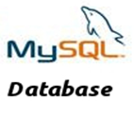
How server side scripting works
Web Server
1. User requests a php page or a
html page that incudes a php script from the web server
2. If a PHP page is requested the server passes the page to the PHP Interpreter
5. Here you go !
3. PHP Interpreter runs
the php script i.e. Maybe
get some data from a
database
6. All the browser sees is HTML,
the PHP and database is
completely hidden
4. Dynamic web page is created

Slide 5
How server side scripting works contd.
The visitor’s web browser requests the web page using a standard URL.
The web server software (Apache, IIS, or whatever) recognises that the requested file is a PHP script and so the server interprets the file using its PHP plug-in, before responding to the page request.
Certain PHP commands in the script connect to the MYSQL database and request the content that belongs in the web page.
The MYSQL database responds by sending the requested content to the PHP script.
The PHP script stores the content into one or more PHP variables, and then uses built in functions such as echo() to output the contents as part of the web page.
The PHP plug in finishes up by handing a copy of the new HTML it has created to the web server.
The web server sends the HTML to the web browser as it would a plain HTML file, except that instead of coming directly from an HTML file, the page is the output provided by the PHP plug-in.

Slide 6
PHP Database Support
Perhaps the strongest and most significant feature in PHP is its support for a wide range of databases. The following databases are currently supported:
PHP also has a database abstraction extension (named PDO) allowing you to transparently use any database supported by that extension.
Additionally PHP supports ODBC, the Open Database Connection standard, so you can connect to any other database supporting this world standard.
http://php.net/manual/en/book.dbx.php
Adabas D | dBase | Empress | FilePro (read-only) | Hyperwave | IBM DB2 | Informix | Ingres
InterBase | mSQL | ODBC | Solid | Unix dbm | Velocis | Sybase | SQLite
FrontBase | Direct MS-SQL | MySQL | Oracle (OCI7 and OCI8) | Ovrimos | PostgreSQL | Access | Mongo
MaxDB | CUBRID | Paradox

Slide 7
What do I need to get started.
MYSQL
– a relational database, situated on your web server.
PHP
– the scripting language also situated on your web server.
Web server software
– we will be using Apache (others include IIS, Sambar). PHP was designed to run as a plug-in for existing web server software.
All software being used is free and can be downloaded off the web.
Before you take an account out with some service provider/host remember to check if they have PHP and MYSQL installed on their server and that you will have access to them. Otherwise you will not be able to run your PHP scripts.

Slide 8
Currently XAMPP is being used in labs.
This is a free and open source cross-platform web server package, consisting mainly of the Apache HTTP Server, MySQL database, and interpreters for scripts written in the PHP and Perl programming languages. This is very quick to download and easy to install.
Use the following link to download XAMPP. http://www.apachefriends.org/en/xampp.html

Slide 9
Basic Syntax & Commands
PHP Files consist of a combination of:
– Regular HTML
– PHP code
With PHP, you can write the presentation aspects of your site in regular HTML. Where the content belongs in those pages, you can use PHP code to connect to the MYSQL database and using SQL queries retrieve and display some content in its place.

Slide 10
Syntax
The rules that must be followed to write properly structured code.
PHP's syntax and semantics are similar to most other programming languages (C, Java, Perl) with the addition that all PHP code is contained with a tag, of sorts.
All PHP code must be contained within the following.
or the shorthand PHP tag that requires shorthand support to be enabled on your server.
If you are writing PHP scripts and plan on distributing them, we suggest that you use the standard form (which includes the ?php) rather than the shorthand form. This will ensure that your scripts will work, even when running on other servers with different settings.
<?php
?>
<?
?>

Slide 11
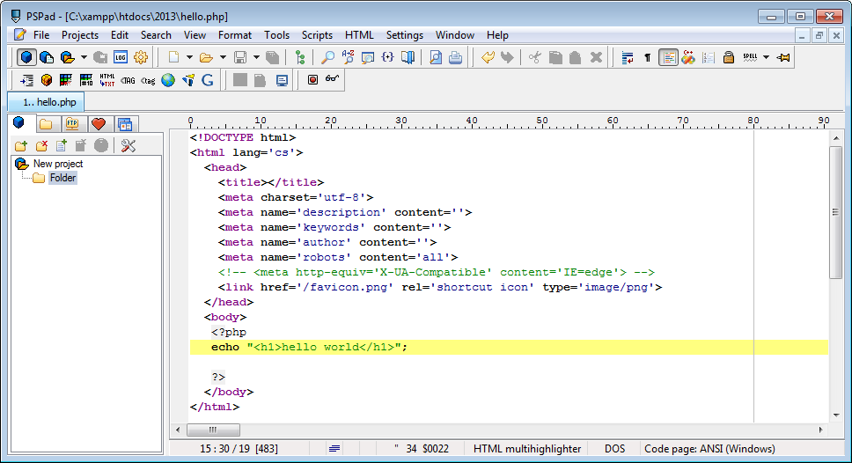
Lets get started..
Open up a new html file in pspad.
Add the following lines directly inside the body tags.
<?php
echo "<h1>Hello, World!</h1>";
?>

Slide 12
How to Save Your PHP Pages
If you have any PHP inserted into your HTML and want the web browser to interpret it correctly, then you must save the file with a .php extension, instead of the standard .html extension.
Note that to save a file with a .php extension in pspad, you’ll need to either select “php” as the save as type, or surround the filename with quotes “ “ in the save as dialog, otherwise pspad will save the file with the extension of the file type created, i.e. if you created a html file that’s the extension that would be added automatically.
Save the file as Hello.php in the following directory
C:\xampp\htdocs\yourfolder
(where you will create the folder called yourfolder)
Example: C:\xampp\htdocs\anne
All your html or php files for this class will be saved in the above folder as this is where Apache looks for files on the server.
Remember - always save the file as xxx.php if there is PHP code in the file.

Slide 13
How to View your PHP Pages
To open this file you have just created, you type the following into your browser:
http://localhost/anne/Hello.php.
Note you cannot open the file using the File | Open method, because the web server must intervene to interpret the PHP in the file. This applies if you are viewing the file on your own machine.

Slide 14
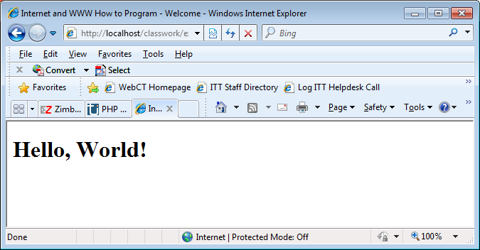
This is what you should see after running the Hello.php file.
Now click View | Source to see the code.

Slide 15
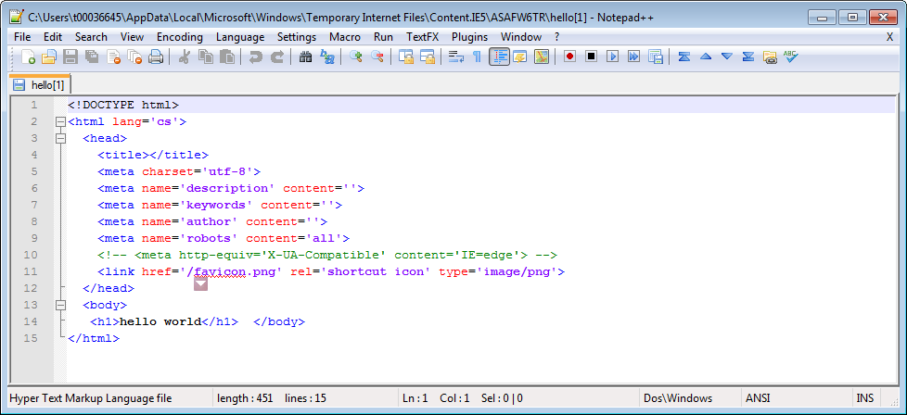
When you view the source of a PHP file from your web browser, you will be surprised to see no PHP code.
This is because all the PHP is executed on the server before it is sent to your browser.
All your browser ever receives is the results of the PHP. The beauty of PHP and other server-side scripting languages is that the web browser doesn’t have to know anything about it – the web server does all the work.

Slide 16
Explain the Code
Lets go back and explain the code we have just written.
To output text in your PHP script is actually very simple. As with most other things in PHP, you can do it in a variety of different ways. The main one you will be using, though, is echo. echo will allow you to output text, variables or a combination of the two so that they display on the screen. The echo statement is used in the following way: echo "Hello world!"; I will explain the above line:
echo is a language construct that prints something out to the screen.
This is followed by the information to be printed. Because you are outputting text, the text is also enclosed inside quotation marks (can use single or double…. I will explain the differences later).
Finally, as with every statement in a PHP script, it must end in a semicolon (;).
And, of course, the code is enclosed in your standard PHP tags.
The echo construct simply takes the text that it’s given, and places it into the HTML code of the page at the current location.

Slide 17
Another Simple Example
Create a new file that contains the following php code.
Here we are using the echo construct again to output todays date.
First we will open the double quotes. Anything enclosed in double quotes is interpreted as a string and will be outputted as typed.
The we output the opening <p> tag – this will make sure that a new paragraph is started. The text todays date is will then output.
Now we close the “” as this is the end of our hardcoded text string.
Next we use the concatenation operator - (the . ). This is used to join 2 strings together. Here we are going to join on the output from a function called date.
We then use the concatenation operator again to join the string containing the closing </p> tag.
<?php
echo "<p> todays date is " . date("l,F dS Y.") . "</p>" ;
?>

Slide 18
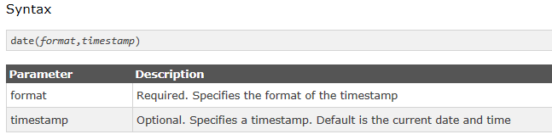
date()
Displays a date in the format specified in the format argument. Dates and times can be displayed in any order and combination, with any delimiters.
d: Numeric day of the month
F: Full month name
l: (lowercase "L") Full day name
S: suffix to numerical date (for example, 1st or 4th)
Y: Four-digit year
A timestamp is a sequence of characters, denoting the date and/or time at which a certain event occurred.
Return value: Returns a formatted date string.
Note that the PHP date() function will return the current date/time of the server!
Further details: http://www.w3schools.com/php/php_ref_date.asp

Slide 19
Some other date() examples
<?php // Assuming today is March 10th, 2001, 5:16:18 pm, and that we are in the // Mountain Standard Time (MST) Time Zone date("F j, Y, g:i a"); // March 10, 2001, 5:16 pm date("m.d.y"); // 03.10.01 date("j, n, Y"); // 10, 3, 2001 date("Ymd"); // 20010310 date('h-i-s, j-m-y, it is w Day'); // 05-16-18, 10-03-01, 1631 1618 6 Satpm01 date('\i\t \i\s \t\h\e jS \d\a\y.'); // it is the 10th day. date("D M j G:i:s T Y"); // Sat Mar 10 17:16:18 MST 2001 date('H:m:s \m \i\s\ \m\o\n\t\h'); // 17:03:18 m is month date("H:i:s"); // 17:16:18 date("Y-m-d H:i:s"); // 2001-03-10 17:16:18 (the MySQL DATETIME format) ?>
Notes:
Some examples of date() formatting. Note that you should escape any other characters, as any which currently have a special meaning will produce undesirable results, and other characters may be assigned meaning in future PHP versions. When escaping, be sure to use single quotes to prevent characters like \n from becoming newlines.

Slide 20

Get Your Time Zone
If the time you got back from the code is not the right time, it's probably because your server is in another country or set up for a different timezone.
So, if you need the time to be correct according to a specific location, you can set a timezone to use.
The example below sets the timezone to America/New_York", then outputs the current time in the specified format:
http://php.net/manual/en/timezones.php

Slide 21
Try this
Output your name and address on separate lines. Use the <h2> tag to format your text.
One thing to note – when you outputting tags within echo the rules from HTML still apply i.e. block tags v’s inline tags etc.

Slide 22
Advantages of Server-Side Scripting:
No browser compatibility issues:
PHP scripts are interpreted by the web server and nothing else, so you don’t have to worry about whether the language you are using will be supported by your visitor’s browsers.
Access to server-side resources:
In the above example, we placed the date according to the web server into the web page. If we had inserted the date using JavaScript, we would only be able to display the date according to the computer on which the web browser was running. Now, while this isn’t an especially impressive example of the exploitation of server-side resources, we could just as easily have script running on the web server, for example, information stored in a MySQL database that runs on the web server computer.
Reduced load on the client:
JavaScript can significantly slow down the display of a web page on slower computers as the browser must run the script before it can display the web page. With server-side scripting, this becomes the burden of the web server machine.

Slide 23
Where can I place my PHP code?
When PHP parses a file, it looks for opening and closing tags, which tell php to start and stop interpreting the code between them.
Parsing in this manner allows php to be embedded in all sorts of different documents, as everything outside of a pair of opening and closing tags is ignored by the PHP parser.
Most of the time you will see php embedded in HTML documents, as in this example.
<p>This is going to be ignored.</p> <?php echo “While this is going to be parsed.”; ?> <p>This will also be ignored.</p>

Slide 24
You can also use more advanced structures:
This works as expected, because when PHP hits the ?> closing tags, it simply starts outputting whatever it finds until it hits another opening tag. The example given here is contrived, of course, but for outputting large blocks of text, dropping out of PHP parsing mode is generally more efficient than sending all of the text through echo or print().
<?php if ($expression) { ?> <strong>This is true.</strong> <?php } else { ?> <strong>This is false.</strong> <?php } ?>

